Slide 1
W1: Static Catbook in React
Samvit Das
Abby Chou

Slide 2

Let’s recap React!

Slide 3
React Review
Break down your UI into reusable, modular components.
Each component can take in props (inputs), and manages its owned contained state (mutable data)
Components interact with each other through parent-child relations in which props are passed down. (Like a tree!)

Slide 4


How to write any website
<App />
1 line of code!

Slide 5
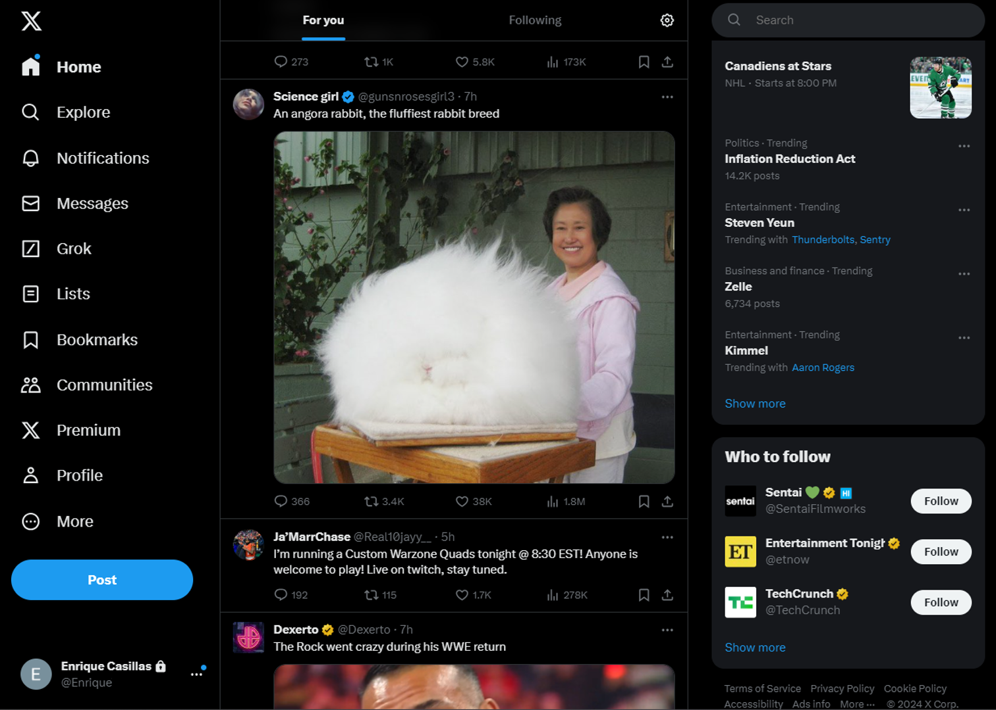
Recap: Break down a website into components
The root component (<App/>)
Notes:
Ask people to identify components

Slide 6
Recap: Break down a website into components
<Navbar/>
<Trending/>
<Suggestions/>
<Feed/>
Notes:
Ask people to identify components

Slide 7
Recap: Break down a website into components
<Profile/>
<Tweet/>
Notes:
Ask people to identify components

Slide 8
Recap: Break down a website into components
Notes:
Other possible components

Slide 9
Recap: Break down a website into components
Notes:
Other possible components

Slide 10
Recap: Props
Information passed from a parent to a child component
These are all props! (the inputs)
<Post name="Samvit" text="Welcome to web.lab!" />
props = {name: "Samvit", text: "Welcome to web.lab!"}

Slide 11
Recap: State
Updatable pieces of information maintained by a component
const [status, setStatus] = useState("busy");
const [isOnline, setIsOnline] = useState(false);

Slide 12
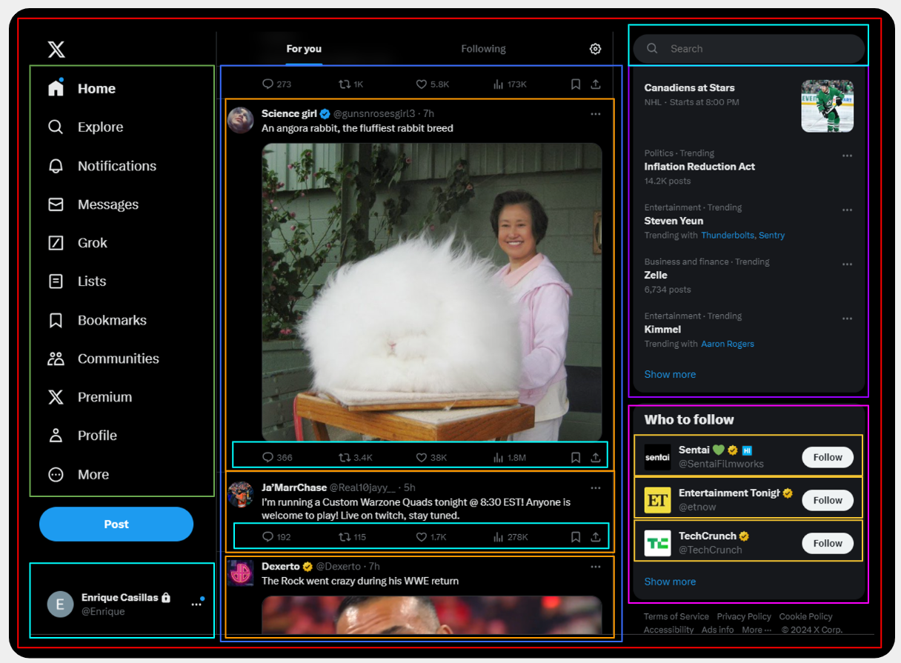
Recap: Creating the component tree
<App/>
<Navbar/>
<Feed/>
<Trending/>
<Suggestions/>
<Tweet/>
<Profile/>
Notes:
PROPS PASS DOWN !!! very very important. REMEMBER that props pass DOWN. On the component tree, if you structure your post above your feed, this will make prop passing very very very difficult.
Next we’ll go through a few examples of how to implement

Slide 13
Recap: Creating the component tree
<App/>
<Navbar/>
<Suggestions/>
App (App.js)
<Feed/>
<Trending/>
const App = () => {
return (
<div>
<Navbar />
<Feed />
<div>
<Trending />
<Suggestions />
</div>
</div>
)
}
State: None
Props: None
Notes:
PROPS PASS DOWN !!! very very important. REMEMBER that props pass DOWN. On the component tree, if you structure your post above your feed, this will make prop passing very very very difficult.

Slide 14
Recap: Creating the component tree
…
<Feed/>
Feed (Feed.js)
<Tweet/>
const Feed = () => {
const [tweetData, setTweetData] = useState([]);
const loadTweets= (() => {
// Load tweets from API...
setTweetData(loadedTweets);
})();
return (
<div>
<Tweet username={tweetData[0].username} ... />
<Tweet username={tweetData[1].username} ... />
<Tweet username={tweetData[2].username} ... />
...
</div>
)
}
State: All tweet data in the feed
Props: None
Notes:
PROPS PASS DOWN !!! very very important. REMEMBER that props pass DOWN. On the component tree, if you structure your post above your feed, this will make prop passing very very very difficult.

Slide 15
Recap: Creating the component tree
…
<Feed/>
<Tweet/>
Tweet (Tweet.js)
const Tweet = (props) => {
return (
<div>
<div className=”tweet-header”>
<img src={props.profilePicture} />
<span>{props.username}</span>
<span>{props.datePosted}</span>
</div>
<p>{props.content}</p>
... // Replies, retweet, etc.
</div>
)
}
State: None
Props: Individual tweet data
Notes:
PROPS PASS DOWN !!! very very important. REMEMBER that props pass DOWN. On the component tree, if you structure your post above your feed, this will make prop passing very very very difficult.

Slide 16

Exercise: Creating Suggestions
…
<Suggestions/>
Suggestions (Suggestions.js)
<Profile/>
const Suggestions = (?) => {
???
return (
<div>
???
</div>
)
}
*Hint: Similar to Feed
State: ?
Props: ?
Notes:
PROPS PASS DOWN !!! very very important. REMEMBER that props pass DOWN. On the component tree, if you structure your post above your feed, this will make prop passing very very very difficult.

Slide 17
Exercise: Creating Suggestions
…
<Suggestions/>
Suggestions (Suggestions.js)
<Profile/>
const Suggestions = () => {
const [profileData, setProfileData] = useState([]);
const loadSuggestions = (() => {
// Load suggested profiles from API...
setProfileData(loadedProfiles);
})();
return (
<div>
<Profile username={profileData[0].username} ... />
<Profile username={profileData[1].username} ... />
<Profile username={profileData[2].username} ... />
...
</div>
)
}
State: All post data in the feed
Props: None
Notes:
PROPS PASS DOWN !!! very very important. REMEMBER that props pass DOWN. On the component tree, if you structure your post above your feed, this will make prop passing very very very difficult.

Slide 18
Exercise: Creating Suggestions
…
<Suggestions/>
<Profile/>
Profile (Profile.js)
const Profile = (?) => {
???
return (
<div>
???
</div>
)
}
State: ?
Props: ?
Notes:
PROPS PASS DOWN !!! very very important. REMEMBER that props pass DOWN. On the component tree, if you structure your post above your feed, this will make prop passing very very very difficult.

Slide 19
Exercise: Creating Suggestions
…
<Suggestions/>
<Profile/>
Profile (Profile.js)
const Profile = (props) => {
return (
<div>
<img src={props.profilePicture} />
<div>
<span>{props.username}</span>
<span>{props.handle}</span>
</div>
<button>Follow</button>
</div>
)
}
State: None
Props: Individual profile data
Notes:
PROPS PASS DOWN !!! very very important. REMEMBER that props pass DOWN. On the component tree, if you structure your post above your feed, this will make prop passing very very very difficult.

Slide 20
Recap
A React component lets you break down a chunk of your UI into a reusable and independent piece of code.
A component can be represented as a piece of HTML code, other React components, or both.
It can receive and maintain its own information
React uses a component tree structure to pass information
Each component can take in props (inputs), and manages its owned contained state (mutable data)
Check out our recap guide at http://weblab.is/react-guide

Slide 21
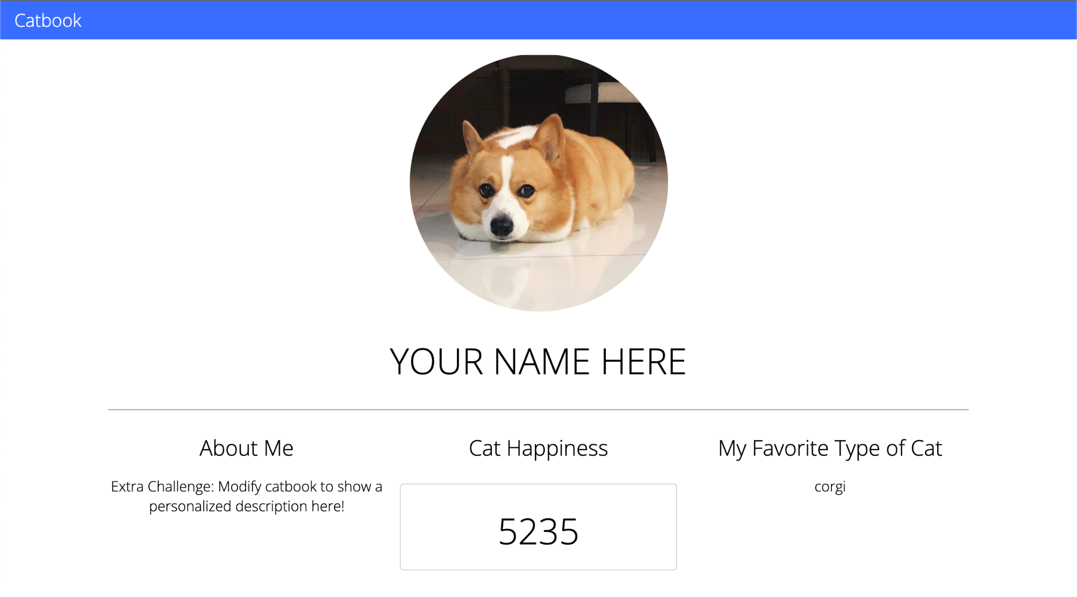
Workshop 1: Catbook w/ React

Slide 22
our end goal!

Slide 23
Setup and Starter Code

Slide 24
Node Setup
Let's make sure everyone has the right version of node! (should have been installed in HW0)
Type
node -v
Anything version 18+ will be good.

Slide 25
Node Setup
1. Open the catbook-react folder in VS Code
2. Open the terminal window in VS Code, make sure you are in the 'catbook-react' folder
3. Run the following commands:
git fetch
git reset --hard
git checkout w1-starter
npm install

Slide 26
First: the component tree for Catbook!
<App/>
<NavBar/>
<Profile/>
?
<CatHappiness/>
workshop 3 progress
workshop 1 progress
starter
starter
step1
step2
step2
complete
complete
step1
Notes:
We’ve predefined the component tree for you all.

Slide 27
First: the component tree for Catbook!
<App/>
<NavBar/>
<Profile/>
<CatHappiness/>
?
workshop 3 progress
workshop 1 progress
starter
starter
step1
step2
step2
complete
complete
step1

Slide 28
First: the component tree for Catbook!
<App/>
<NavBar/>
<Profile/>
<CatHappiness/>
workshop 3 progress
workshop 1 progress
starter
starter
step1
step2
step2
complete
complete
step1

Slide 29




Understanding the Starter Code
*No need to edit any CSS besides Navbar.css!
components/
App.js
modules/
pages/
*Entry point, no need to edit!
You will only modify these four files
CatHappiness.js
Navbar.js
Navbar.css
Profile.js
workshop 3 progress
workshop 1 progress
starter
starter
step1
step2
step2
complete
complete
step1

Slide 30
Notes about Element Classes
We use 'className' instead of class in React
We put the React component name in front of our class names (e.g. className="App-container")
why? so that we don't have the same class name in different components
CSS always applies to the entire webpage, so must include className to make it specific
for example if we set p {color: red} in one component it actually applies to all paragraphs on the whole webpage
workshop 3 progress
workshop 1 progress
starter
starter
step1
step2
step2
complete
complete
step1

Slide 31
Running your Code
npm run dev
Navigate to localhost:5173 and see the page update with your live changes!
workshop 3 progress
workshop 1 progress
starter
starter
step1
step2
step2
complete
complete
step1
Notes:
tell people to ask for help if they don't see this
1 minute to let them get caught up

Slide 32
Step 0:
Implement the Navbar
git reset --hard
git checkout w1-starter

Slide 33

Step 0: Implement React Navbar
git reset --hard
git checkout w1-starter
You’ve implemented Navbar using Vanilla HTML- let’s do it with React!
Tasks:
Navbar.js
Navbar.css
Implement return() in Navbar.js with HTML code
Implement Navbar.css ... go wild! Try to make the NavBar look like the catbook navbar, but feel free to add your own twist!
<div className="style-name">
workshop 3 progress
workshop 1 progress
starter
starter
step1
step2
step1
complete
step2
step0
Notes:
Include naming convention

Slide 34
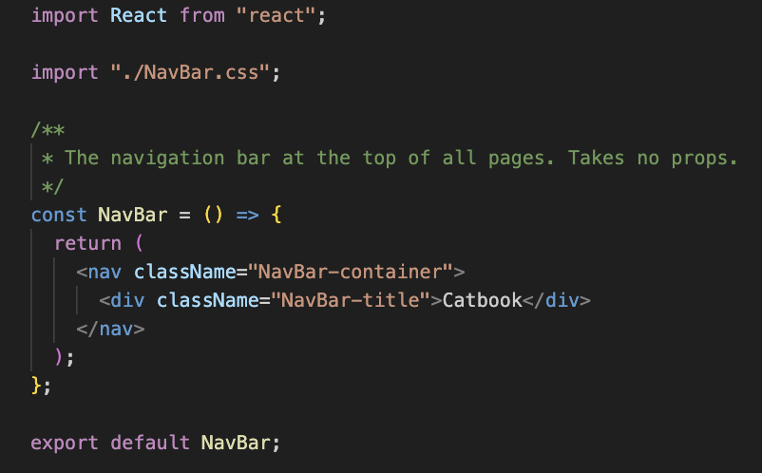
Step 0a: React Navbar JS
git checkout w1-starter
// NavBar.js
workshop 3 progress
workshop 1 progress
starter
starter
step1
step2
step1
complete
step2
step0

Slide 35
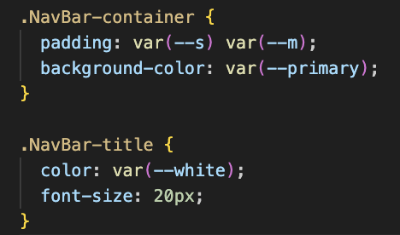
Step 0b: React Navbar CSS
git checkout w1-starter
workshop 3 progress
workshop 1 progress
starter
starter
step1
step2
step1
complete
step2
step0

Slide 36
Step 1:
Adding CatHappiness

Slide 37
Which component should store the 'catHappiness' state?
<App/>
<NavBar/>
<Profile/>
<CatHappiness/>
workshop 3 progress
workshop 1 progress
starter
starter
step1
step2
step1
complete
step2
step0

Slide 38
Why Profile? We want to update 'catHappiness' when the cat is clicked
<App/>
<NavBar/>
<Profile/>
<CatHappiness/>
Clicking on the cat needs to update catHappiness, and the cat is in Profile!
workshop 3 progress
workshop 2 progress
workshop 3 progress
workshop 1 progress
starter
starter
starter
starter
complete
complete
complete
step2
step2
step2
step2
step1
step1
step1
step1
step0

Slide 39
<App/>
<Profile/>
<NavBar/>
Props
State
None
catHappiness
<CatHappiness/>
Props
State
catHappiness
None
workshop 3 progress
workshop 2 progress
workshop 3 progress
workshop 1 progress
starter
starter
starter
starter
complete
complete
complete
step2
step2
step2
step2
step1
step1
step1
step1
step0

Slide 40
How do we add state to a component?
workshop 3 progress
workshop 1 progress
starter
starter
step1
step2
step1
complete
step2
step0

Slide 41
How do we add state to a component?
const [something, setSomething] = useState(defaultValue)
... we use useState!!
workshop 3 progress
workshop 1 progress
starter
starter
step1
step2
step1
complete
step2
step0

Slide 42

Let's get on the same page
git reset --hard git checkout w1-step1
Save or close out of all of your 'unsaved' files:
*If it doesn't let you checkout and says 'Please commit your changes or stash them', then 'git stash' should do the trick and you should be able to checkout

Slide 43
Step 1: Adding CatHappiness
git reset --hard
git checkout w1-step1
Tasks:
Add the catHappiness state to Profile.js
Import the <CatHappiness/> Component in Profile.js
Add the <CatHappiness/> component to Profile.js
Display the catHappiness state in the <CatHappiness/> component using props
Import useState: import React, { useState } from "react"
Create a state: const [something, setSomething] = useState(defaultValue)
Pass a prop into a component: <Component propName={propValue} />
Profile.js
CatHappiness.js
workshop 3 progress
workshop 1 progress
starter
starter
step1
step2
step1
complete
step2
step0
Notes:
Include naming convention

Slide 44
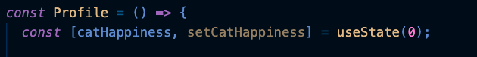
Step 1a: Add the 'catHappiness' state to Profile
git checkout w1-step1
// Profile.js (also don't forget to import useState)
workshop 3 progress
workshop 1 progress
starter
starter
step1
step2
step1
complete
step2
step0

Slide 45
Step 1b: Import the CatHappiness Component
git checkout w1-step1
// Profile.js
workshop 3 progress
workshop 1 progress
starter
starter
step1
step2
step1
complete
step2
step0
Notes:
30 seconds

Slide 46
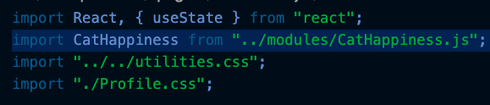
Step 1b: Import the CatHappiness Component
git checkout w1-step1
// Profile.js
workshop 3 progress
workshop 1 progress
starter
starter
step1
step2
step1
complete
step2
step0

Slide 47
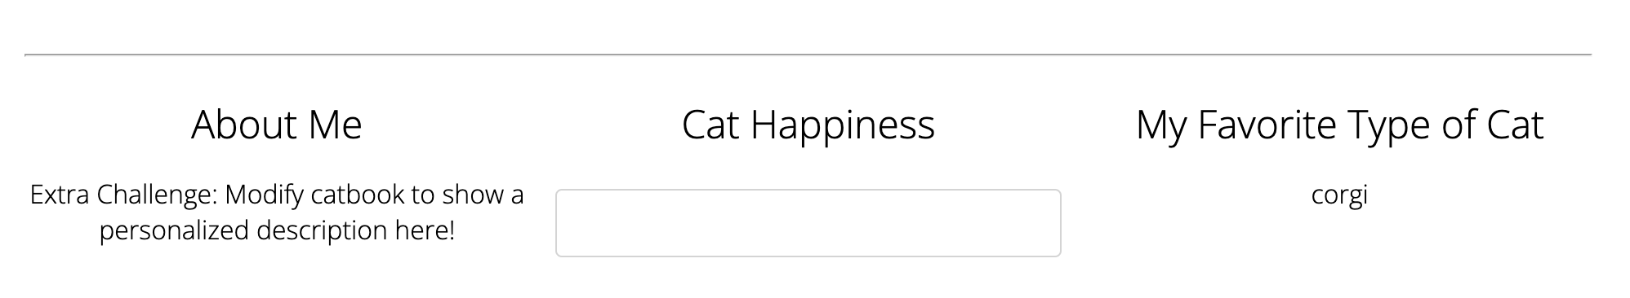

Step 1c: Add the CatHappiness component
git checkout w1-step1
Add in the CatHappiness component to Profile.js (in the TODO STEP 1c area), as well as a header in front of it to look like:
Also, pass in catHappiness as a prop! Don’t forget, the syntax will look like:
workshop 3 progress
workshop 1 progress
starter
starter
step1
step2
step1
complete
step2
step0
Notes:
2 min

Slide 48
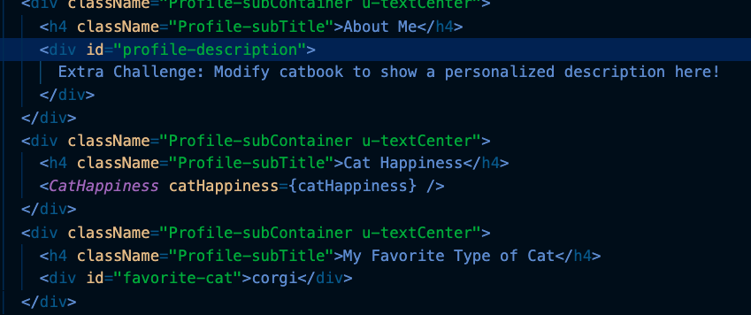
Step 1c: Add the CatHappiness component
git checkout w1-step1
workshop 3 progress
workshop 1 progress
starter
starter
step1
step2
step1
complete
step2
step0

Slide 49
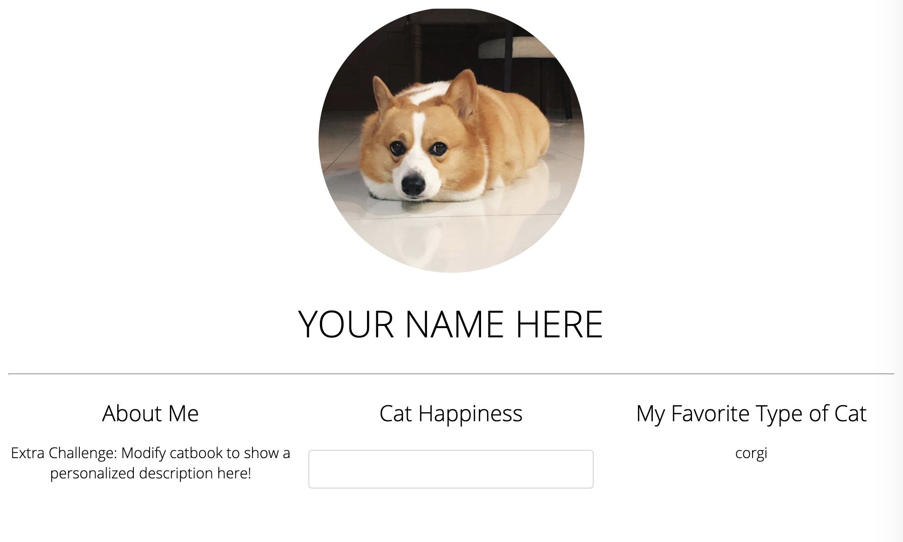
Are we done?
git checkout w1-step1
Notes:
What do we need to do??

Slide 50
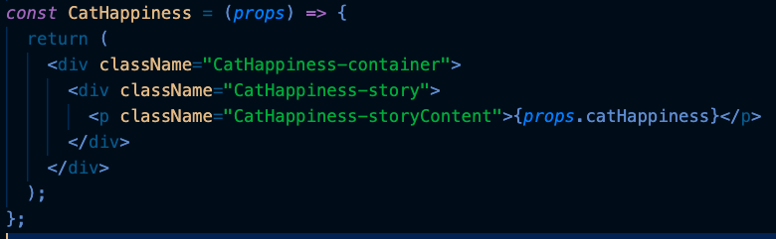
Step 1d: Display the incoming catHappiness Prop
git checkout w1-step1
// CatHappiness.js
workshop 3 progress
workshop 1 progress
starter
starter
step1
step2
step1
complete
step2
step0
Notes:
30 seconds

Slide 51
Step 1d: Display the incoming catHappiness Prop
git checkout w1-step1
// CatHappiness.js
workshop 3 progress
workshop 1 progress
starter
starter
step1
step2
step1
complete
step2
step0

Slide 52
Step 2:
Updating CatHappiness
git reset --hard
git checkout w1-step2

Slide 53
Let's get on the same page
git reset --hard git checkout w1-step2
Save or close out of all of your 'unsaved' files:
*If it doesn't let you checkout and says 'Please commit your changes or stash them', then 'git stash' should do the trick and you should be able to checkout

Slide 54
Step 2: Update catHappiness State
git reset --hard
git checkout w1-step2
Now we need to change the catHappiness when we click our profile pic!
workshop 3 progress
workshop 1 progress
starter
starter
step1
step2
step1
complete
step2
step0

Slide 55
Step 2: Updating catHappiness
git reset --hard
git checkout w1-step2
Tasks:
(Profile.js line 10) Implement incrementCatHappiness
(Profile.js line 15) Call incrementCatHappiness whenever the profile picture is clicked
Profile.js
HINT: All divs have an 'onClick' prop that takes a function. Whenever a div is clicked, it runs its onClick function.
Before we implement, a quick question!
workshop 3 progress
workshop 1 progress
starter
starter
step1
step2
step1
complete
step2
step0
Notes:
Include naming convention. DO ALL STEPS AT ONCE!
5 min

Slide 56
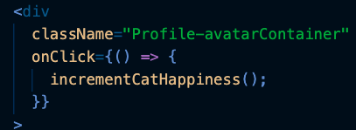
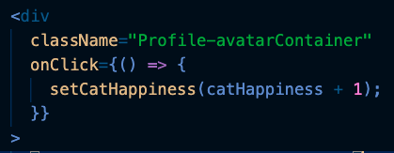
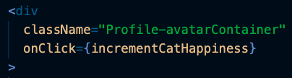
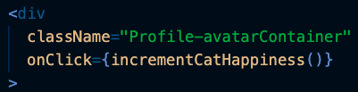
Which of these will work?
A. B. C. D.
workshop 3 progress
workshop 1 progress
starter
starter
complete
complete
step1
step2
step1
step2
step0
Notes:
Can anyone tell me why D doesn’t work?

Slide 57

Which of these will work?
A. B. C. D.
workshop 3 progress
workshop 1 progress
starter
starter
complete
complete
step1
step2
step1
step2
step0
Notes:
A. Works, just not the most readable. Also unnecessary since we aren't doing anything else inside this function.
B. Works and super clean code!! Recommended implementation!
C. Also pretty good
D. Doesn't work since it will execute the function when the div element is created, not when it's clicked on.

Slide 58
Step 2: Updating catHappiness
git reset --hard
git checkout w1-step2
Tasks:
(Profile.js line 10) Implement incrementCatHappiness
(Profile.js line 15) Call incrementCatHappiness whenever the profile picture is clicked
Profile.js
HINT: All divs have an 'onClick' prop that takes a function. Whenever a div is clicked, it runs its onClick function.
workshop 3 progress
workshop 1 progress
starter
starter
step1
step2
step1
complete
step2
step0
Notes:
Include naming convention. DO ALL STEPS AT ONCE!
5 min

Slide 59
Finished App
git reset --hard
git checkout w1-complete
Navigate to localhost:5173 and change the cat happiness by clicking the profile picture!

Slide 60
Recap: Writing Components
We divide our app into c _ _ _ _ _ _ _ _ s, and put one in each file
Each component is a function with p _ _ _s as the input, and returns JSX (HTML-like code)
Each component can store internal updatable private info as
's _ _ _ _' variables
( ) allows us to enter an JSX environment
Inside the JSX environment, {} allows us to create a mini
j _ _ _ _ _ _ _ _ t environment

Slide 61
Recap: Writing Components
We pass in props with <Post text="I love weblab" />
We read in those props with props.text
We declare state variables with
const [something, setSomething] = useState(initialValue)
React uses className instead of class for css styles

Slide 62
weblab.is/react-guide

Slide 63
Next up: React Lifecycle and Hooks

Slide 64
Feedback Time!
weblab.is/feedback

Slide 65
5 min bio break if you need it
And for everyone else…

Slide 66
5 min bio break if you need it
And for everyone else…
Plank challenge vs. Lucas >:)

